Slide 1
Welcome to Spatial Data Logic (SDL)
Creating a User Account to lookup information

Slide 2
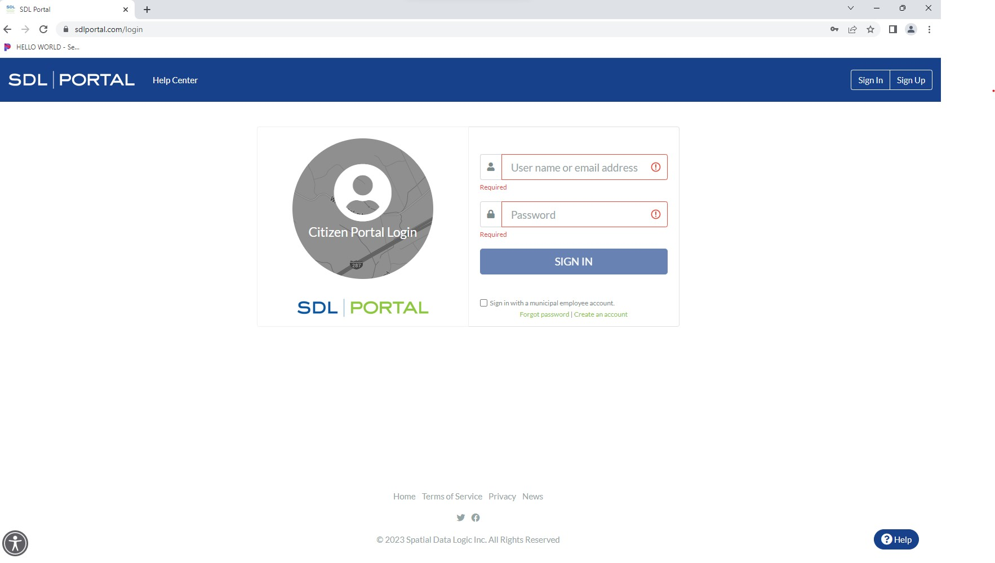
SDL Portal Sign Up
Using any browser, go to www.SDLPortal.com and click on “Sign Up” to create an account

Slide 3
SDL Portal Sign Up
Once you sign up, SDL will send you an email usually within a few minutes, to verify your account
Go to the verification email & click on the link provided by SDL
For Bedminster, you must enter Bedminster Township to see the available property information

Slide 4
Property Search
Once the account is set up & you have logged in, you may search for any property record
Please remember less is more when searching.
i.e. If you are looking for information on 2435 Lamington Road, it’s only necessary to enter 2435 Lam. If it’s in SDL as 2435 Lamington Rd and the word Road is spelled out in your search, the search will return “No Results”

Slide 5
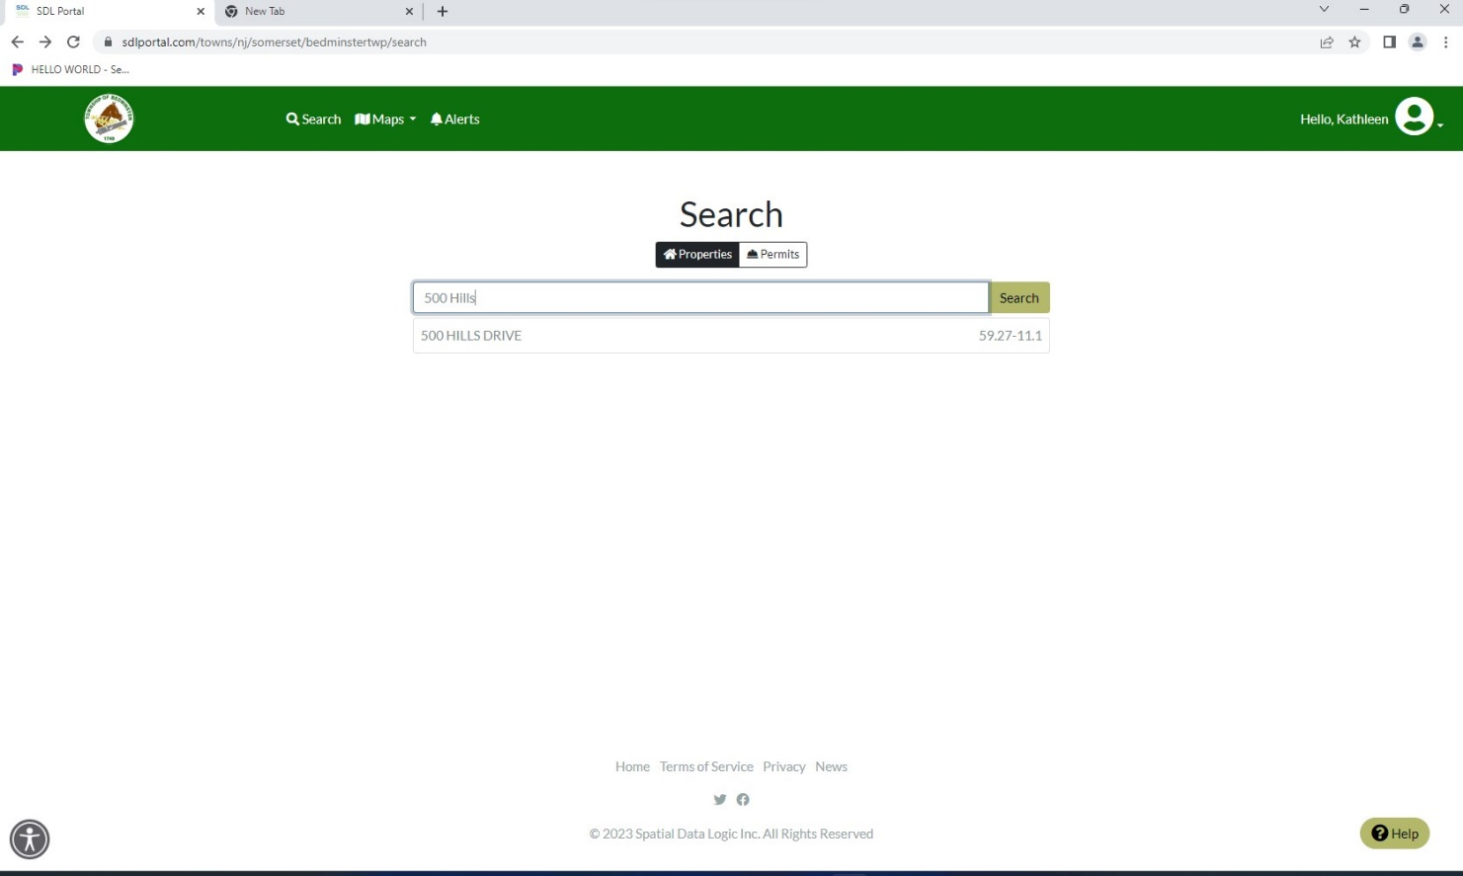
Property Search (cont’d)
Click on property

Slide 6
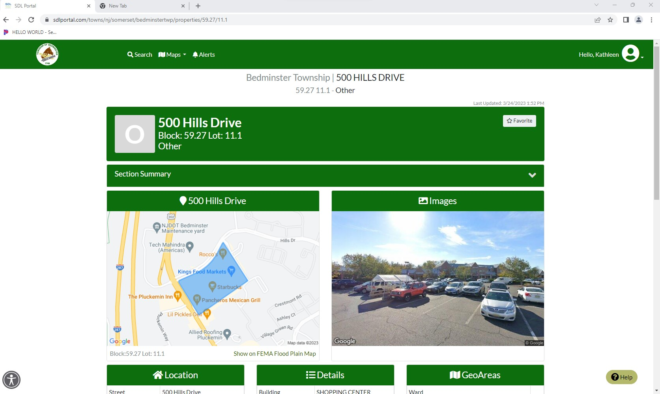
Property Record
Click on Section Summary

Slide 7
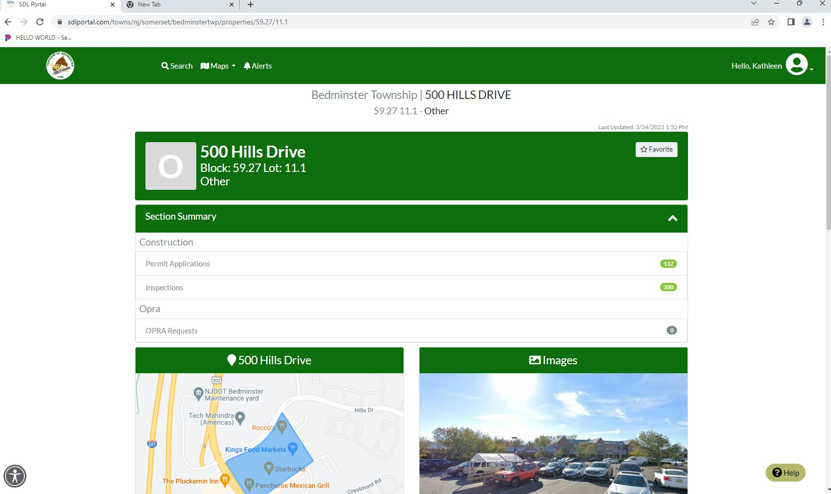
Property Record
Click on either category to see the information

Slide 8
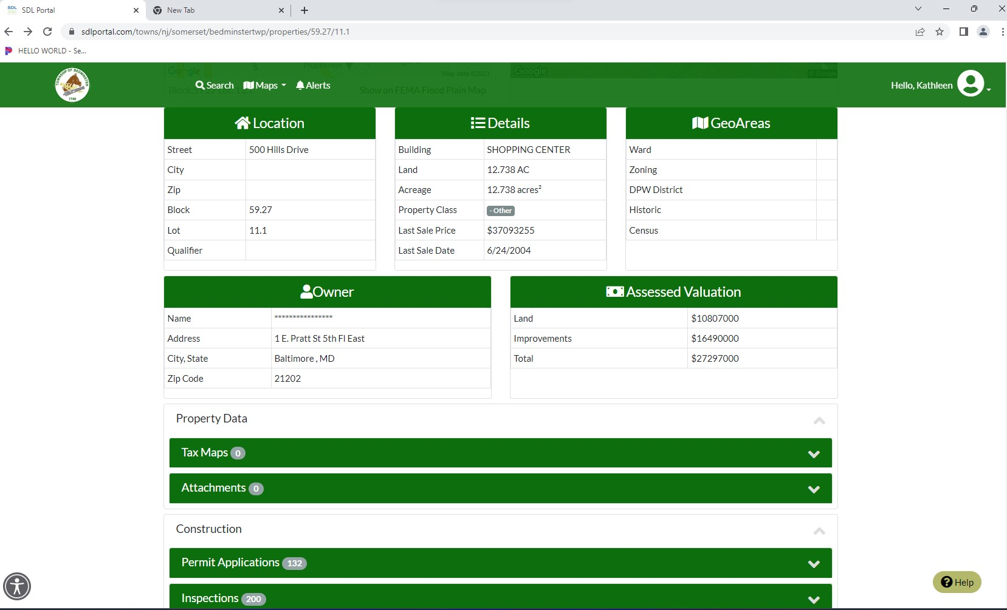
Property Record
Or scroll down to bottom of page for permit & inspection information

Slide 9
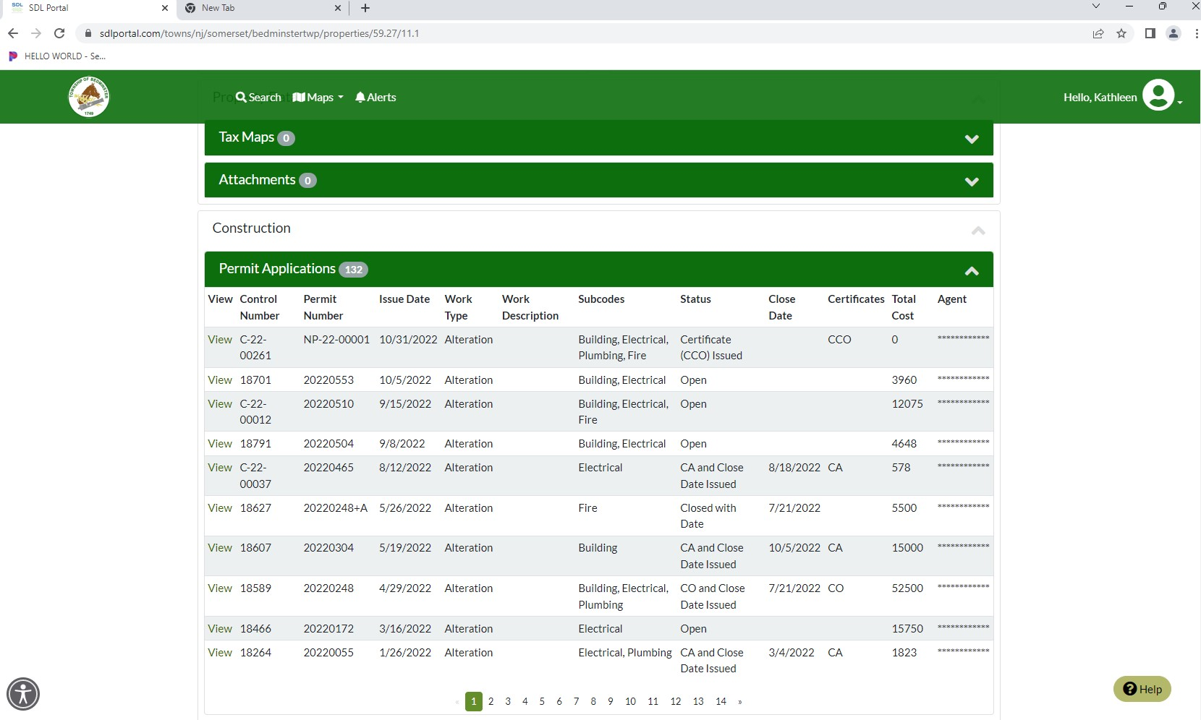
Permit Applications
Click on “View” to see the individual permit application

Slide 10
Permit Applications (cont’d)

Slide 11
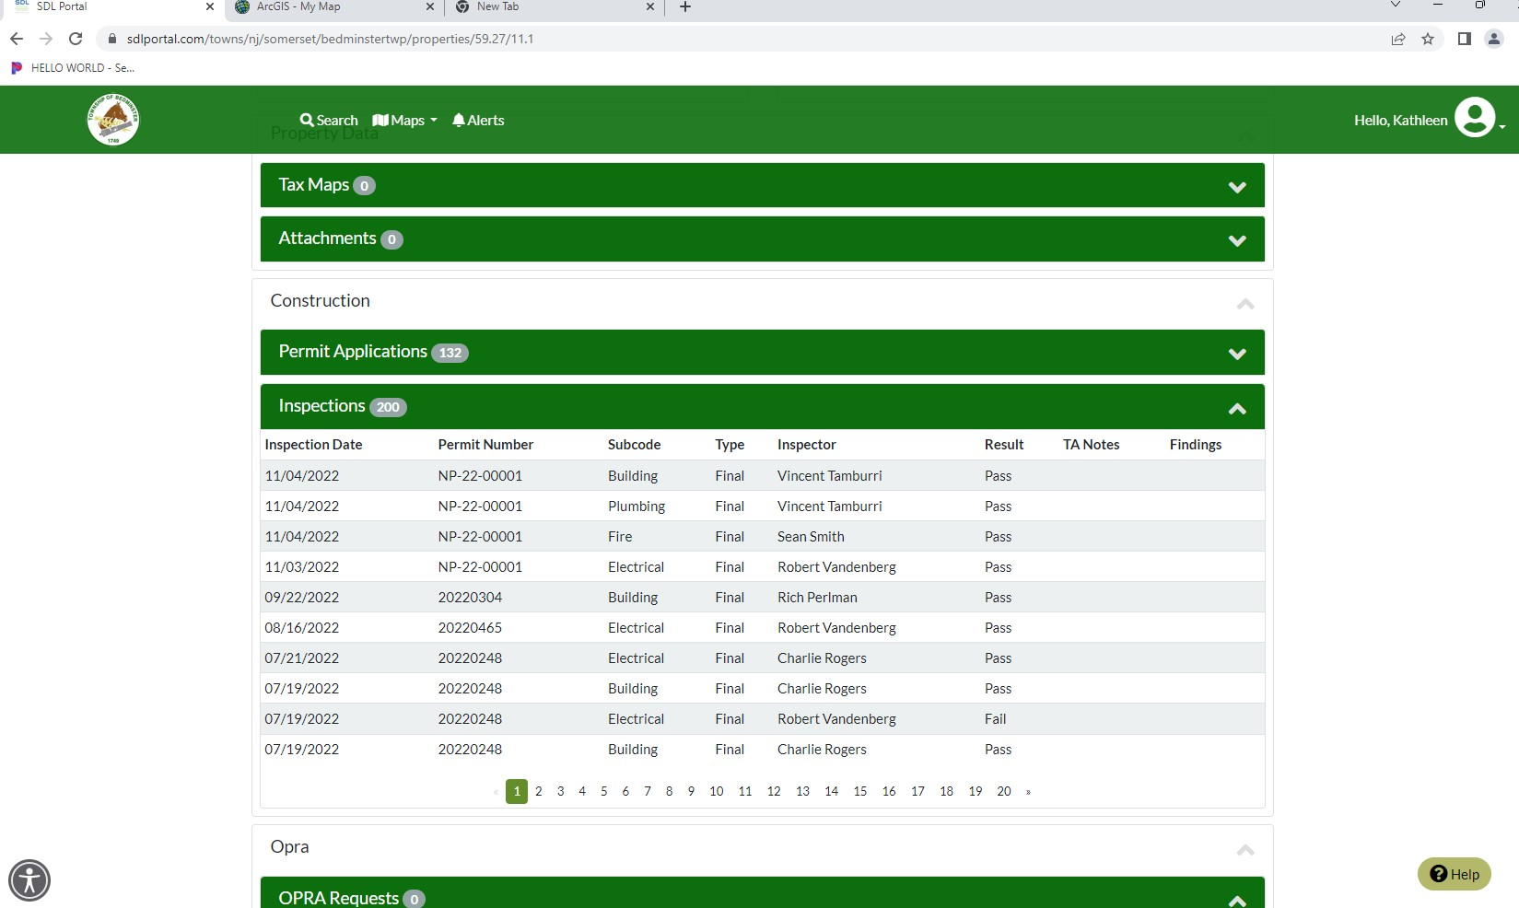
Inspections
To view inspection status, click on inspections

Slide 12
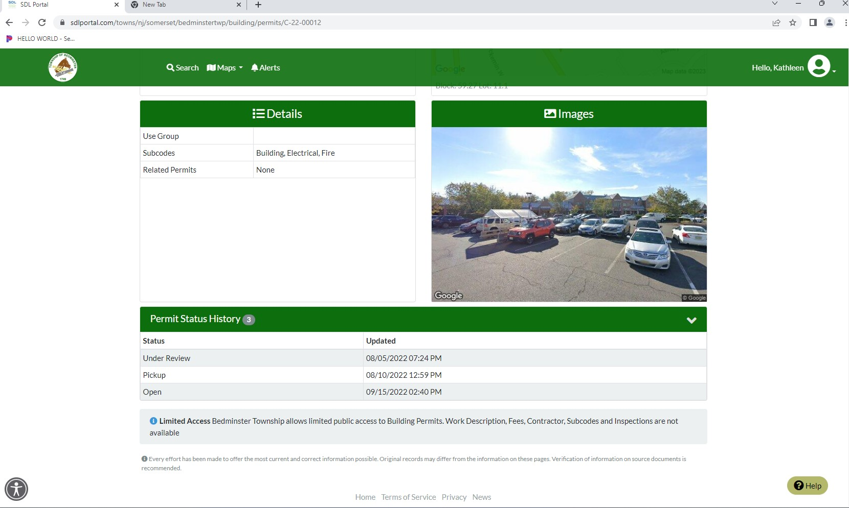
Permit Applications (cont’d)
Scroll down to bottom half of page to see additional details

